Slide 1
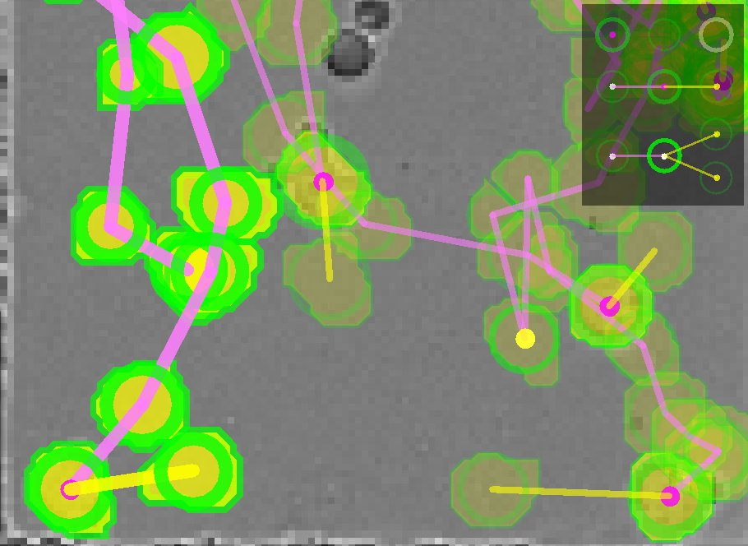
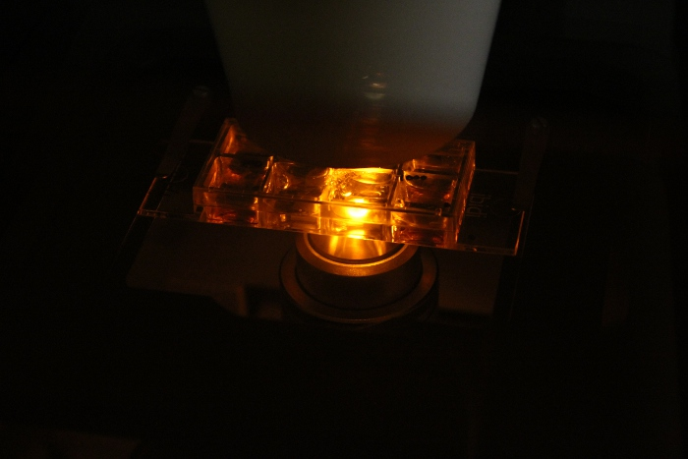
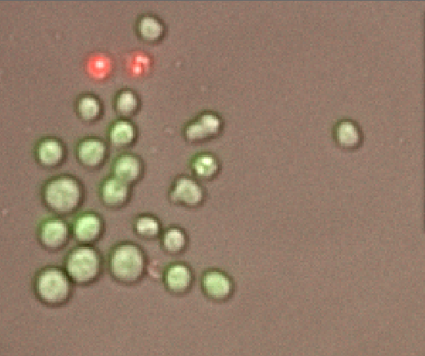
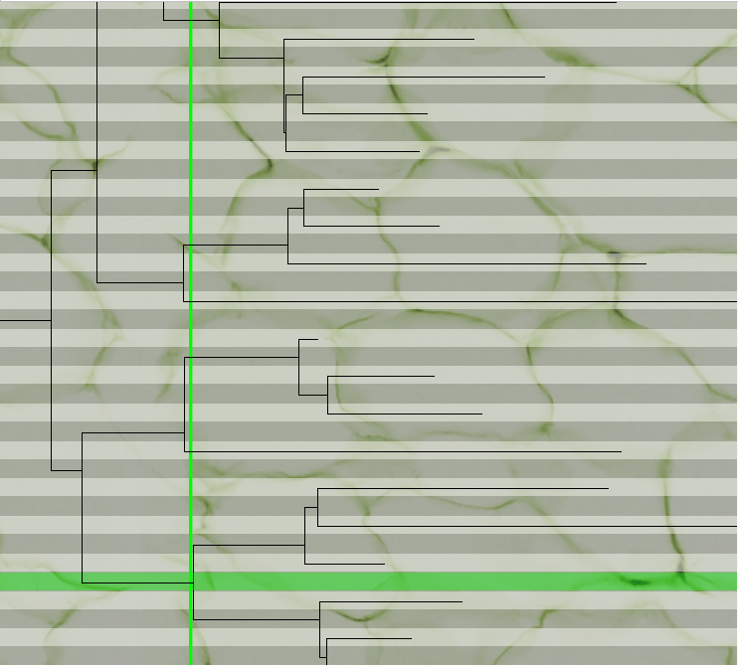
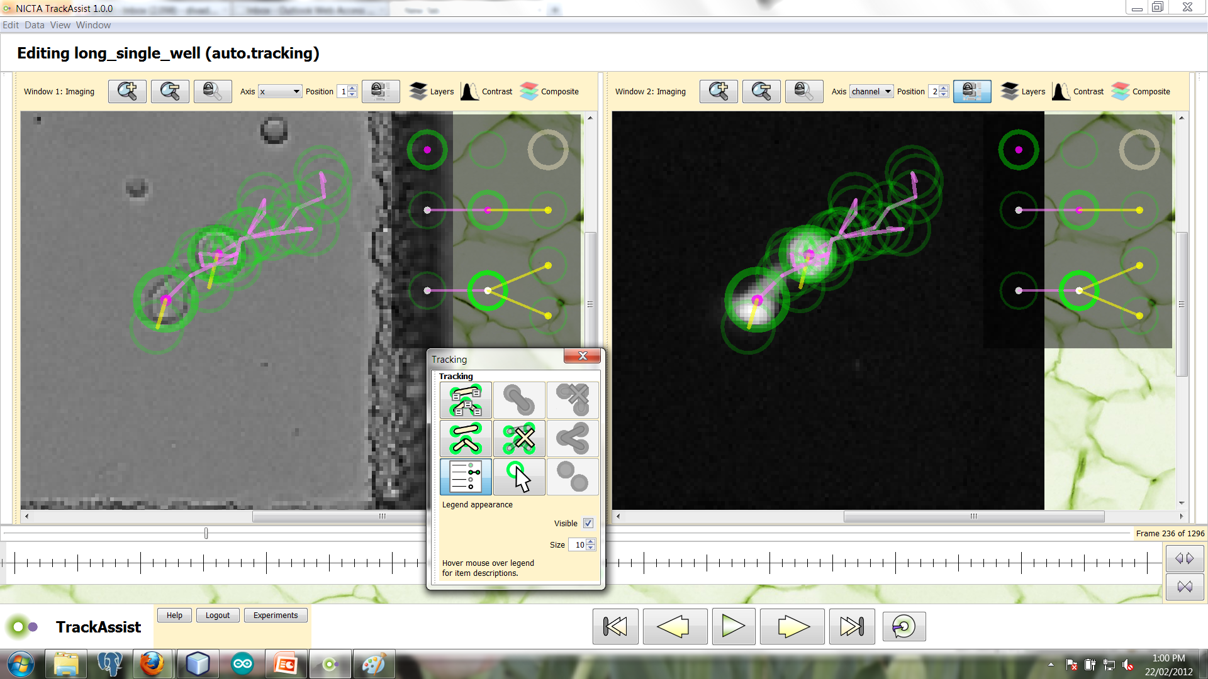
TrackAssist: Extracting cell lineage
from Time-Lapse Microscopy
David Rawlinson, John Markham, Alan Zhang, Rajib Chakravorty
Correspondence: david.rawlinson@nicta.com.au
We are developing software tools for tracking mobile cells in time-lapse microscopy images.
These tools have the potential to save researchers thousands of man-hours,
greatly increasing the ambition and quantity of experiments conducted.
[insert hero image]
Problem/Opportunity
Solution or Approach
Immunology researchers want to reconstruct the lineages of B-Lymphocytes, but this requires tracking every individual cell in populations of hundreds, over a period of several days
The lineage of B-Lymphocytes is critical in determining their fates and behaviour
This was a hugely time-consuming, expert manual task
TrackAssist improves productivity and throughput 20x-30x on this task
NICTA has partnered with the Immunology Lab at Walter & Eliza Hall Institute for medical research (WEHI)
We are combining NICTA’s expertise in object tracking & image processing, with WEHI’s experience of immunology modelling
Jointly developed wet-lab imaging protocols and data-processing algorithms, for optimum results
A specific and novel approach to Immunology, driven by WEHI’s groundbreaking research
Software Status
TrackAssist Features
[optional image or graph]
TrackAssist software released to WEHI collaborators, Feb. 2012
Other Immunology groups will adopt TrackAssist for B-Lymphocyte tracking during 2012
Now extending to T-Lymphocyte in collaboration with HIV research group at the Burnet Institute, Melbourne
Import bio image formats, export segmented images, tracking data & lineage to several formats (e.g. csv)
Fully automatic cell segmentation and tracking
Tools to manually correct or constrain detections & tracks
Add notes & comments to imagery
Visualization & enhancement tools
We are seeking to engage and collaborate with other research groups who face challenging bio-imaging analysis problems
Research Excellence in ICT
Wealth Creation for Australia

